Slide 1
Capstone Engagement
Assessment, Analysis, and Hardening of a Vulnerable System

Slide 2
Table of Contents
This document contains the following sections:
01
Network Topology
02
Red Team: Security Assessment
03
Blue Team: Log Analysis and Attack Characterization
Hardening: Proposed Alarms and Mitigation Strategies
04

Slide 3
Network Topology

Slide 4
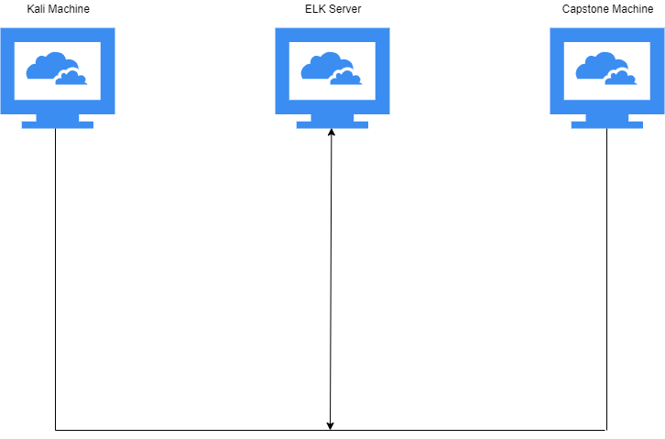
Network Topology
Network
Address Range: 192.168.0.1
Netmask: 255.255.255.0
Gateway: 192.168.1.1
Machines
IPv4: 192.168.0.90
OS: Linux
Hostname: Kali
IPv4: 192.168.0.105
OS: Linux
Hostname: Capstone
IPv4: 192.168.0.100
OS: Windows
Hostname: ELK server
IPv4:
OS:
Hostname:

Slide 5

Red Team
Security Assessment

Slide 6
Recon: Describing the Target
Nmap identified the following hosts on the network:
Hostname | IP Address | Role on Network
Default Gateway | 192.168.1.1 | Router that connects the host to other networks to allow communication.
ELK server | 192.168.1.100 | Gathers and analyzes logs from specific machines/servers and creates visuals from data.
Capstone Machine | 192.168.1.105 | The targeted victim machine
Kali Machine | 192.168.1.90 | The attacker machine

Slide 7
Vulnerability Assessment
The assessment uncovered the following critical vulnerabilities in the target:
Vulnerability | Description | Impact
Use the CVE number if it exists. Otherwise, use the common name. | Describe the vulnerability. | Describe what this vulnerability allows the attacker to do.
Security Misconfiguration | Security policies are poorly configured, leaving systems and data insecure. | Attackers can use any open ports to gain access to system data and control of system.
Unauthorized File Upload | Allows files to be freely uploaded. | This vulnerability allows attackers to upload malicious code that can compromise systems.
Brute Force Vulnerability | Allows access to confidential credentials through repetitve attempts. | Allows attackers gain credentials of a user that potentially has root priviledges.

Slide 8
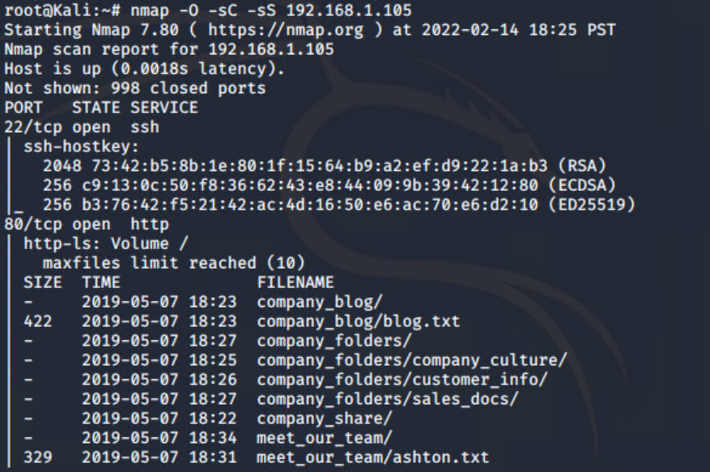
Exploitation: System Misconfiguration
01
02
03
Tools & Processes
Nmap was used to exploit this vulnerability.
Achievements
This exploit allowed access to the domain through detecting an open, vulnerable port 80.

Slide 9
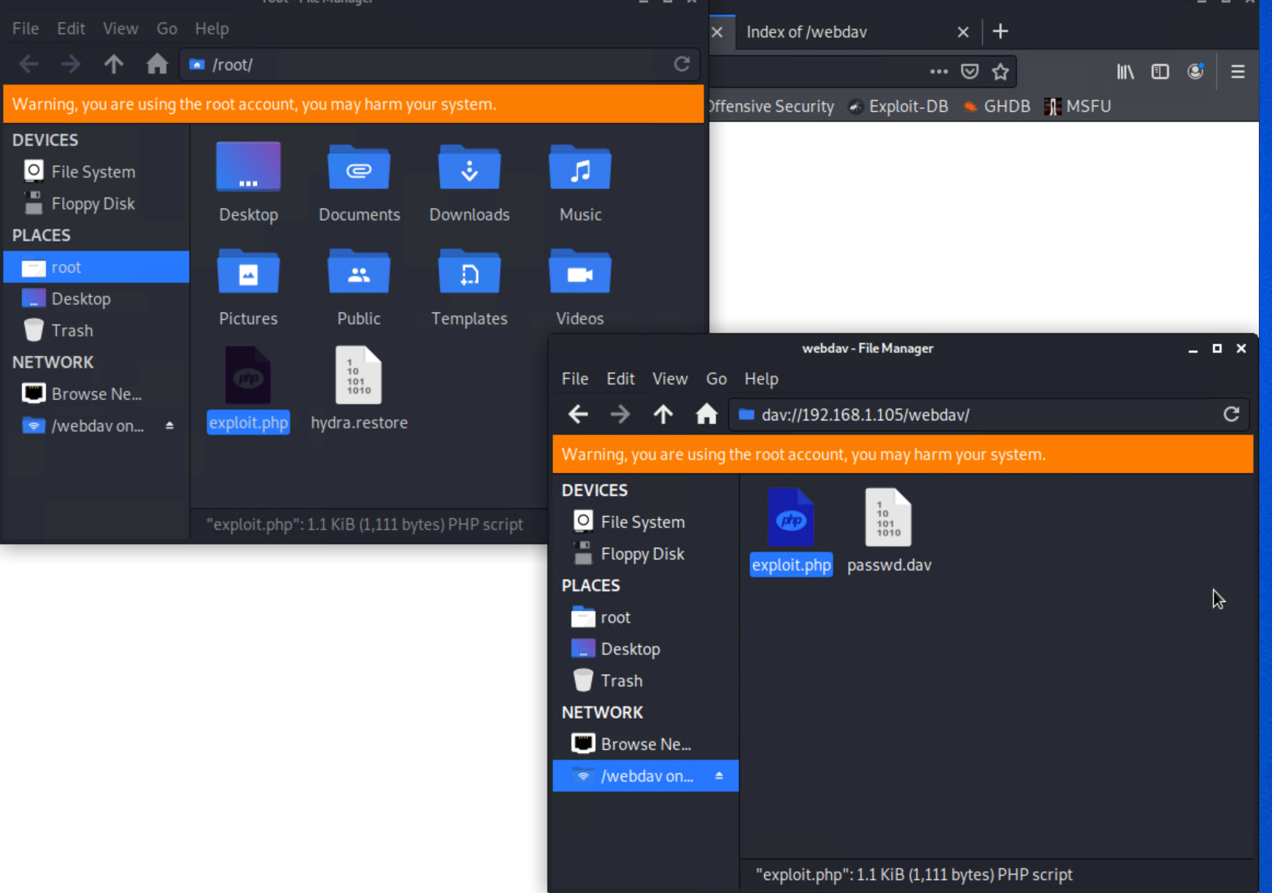
Exploitation: Unauthorized File Upload
01
02
03
Tools & Processes
Kali File Manager’s remote connectability
Achievements
After finding the credentials to gain access to target network, allowed to remotely connect and upload malicious script.

Slide 10
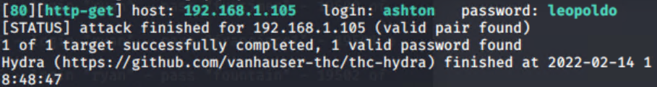
Exploitation: Brute Force Vulnerability
01
02
03
Tools & Processes
hydra command
Achievements
Running the hydra command allowed brute forcing for access to an account that had a file with a root user’s credentials.

Slide 11

Blue Team
Log Analysis and Attack Characterization

Slide 12

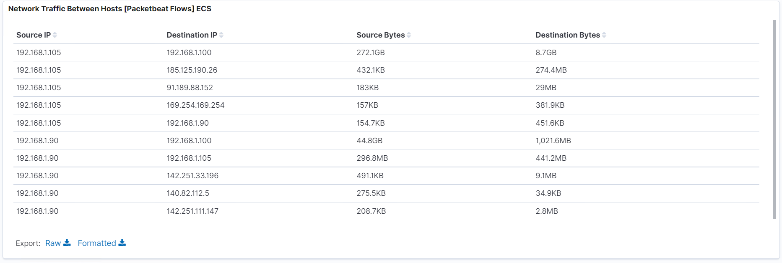
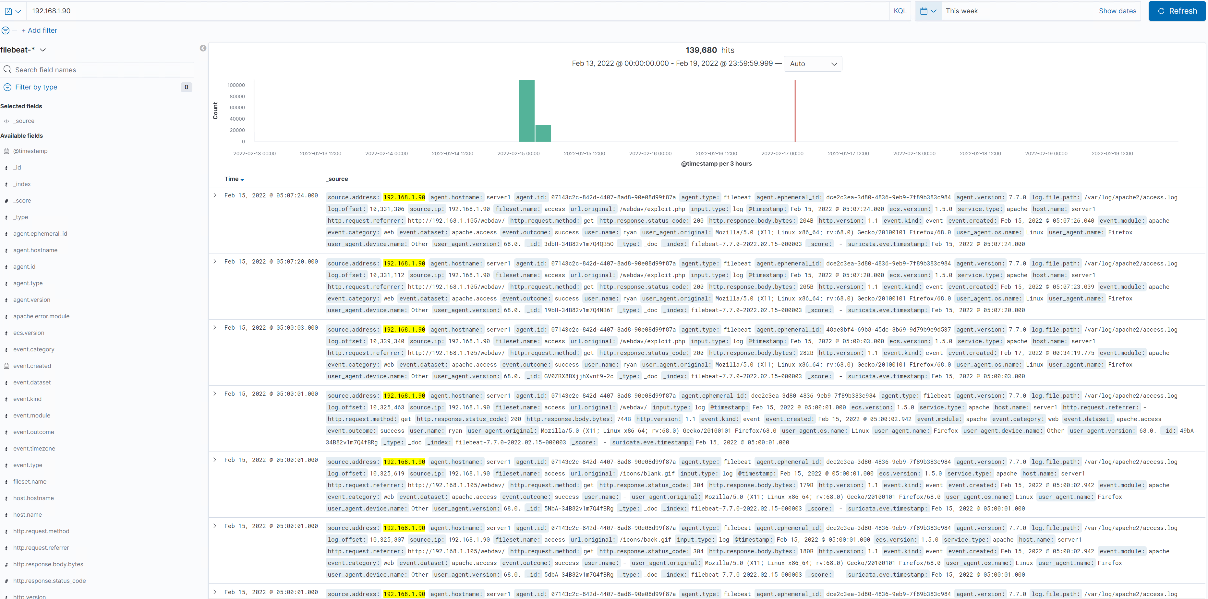
Analysis: Identifying the Port Scan
Answer the following questions in bullet points under the screenshot if space allows. Otherwise, add the answers to speaker notes.
What time did the port scan occur? Feb 15th from 00:00 to 03:00
How many packets were sent, and from which IP? 139,680 from 192.168.1.90
What indicates that this was a port scan? There were consecutive attempts testing different IPs from one source IP

Slide 13
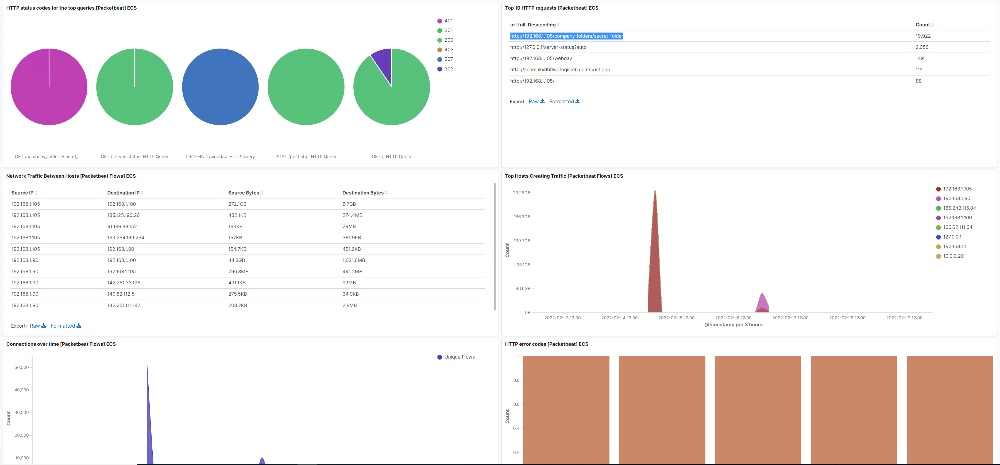
Analysis: Finding the Request for the Hidden Directory
Answer the following questions in bullet points under the screenshot if space allows. Otherwise, add the answers to speaker notes.
What time did the request occur? How many requests were made?
Which files were requested? What did they contain?
There were 19,992 requests to access the secret folder.
Request to the secret folder that contained a password hash

Slide 14
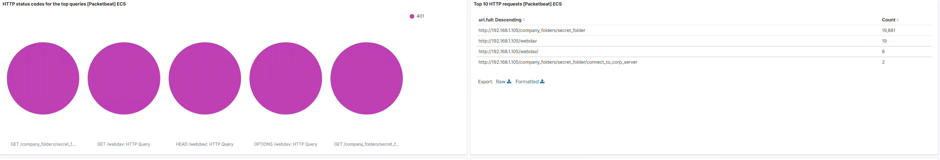
Analysis: Uncovering the Brute Force Attack
Answer the following questions in bullet points under the screenshot if space allows. Otherwise, add the answers to speaker notes.
How many requests were made in the attack?
How many requests had been made before the attacker discovered the password?
There were 19,881 requests during the attack before the attacker discovered the password.

Slide 15
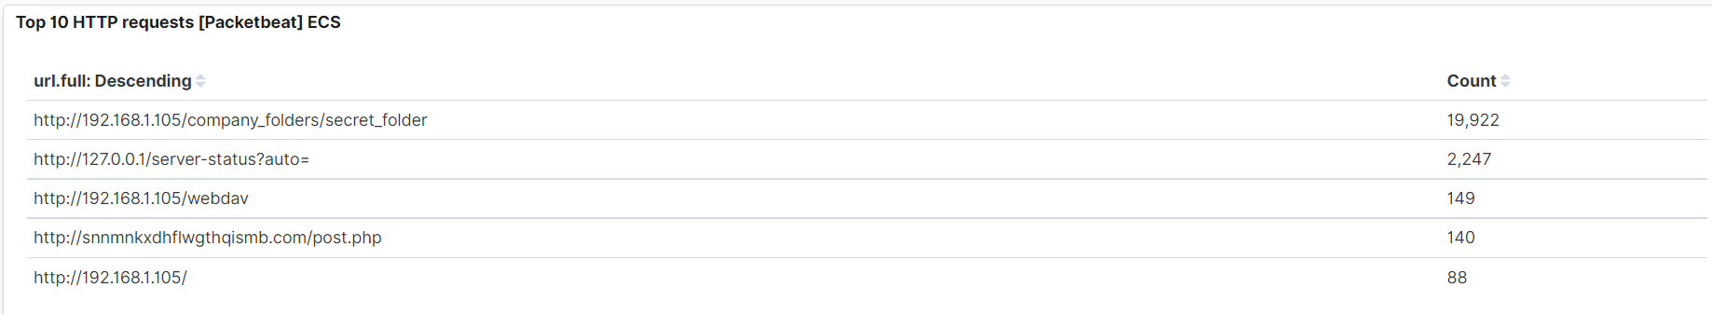
Analysis: Finding the WebDAV Connection
Answer the following questions in bullet points under the screenshot if space allows. Otherwise, add the answers to speaker notes.
How many requests were made to this directory?
Which files were requested?
There were 149 requests to the webdav directory.
exploit.php and passwd.dav

Slide 16
Blue Team
Proposed Alarms and Mitigation Strategies

Slide 17
Mitigation: Blocking the Port Scan
What kind of alarm can be set to detect future port scans?
Future port scans can be detected by implementing an Intrusion Detection System or an Intrusion Prevention System.
What threshold would you set to activate this alarm?
I would set the threshold to the alarm to be 1,000 requests per hour to avoid false positives but still detect large repetitive attempts.
What configurations can be set on the host to mitigate port scans?
Implementing a patched firewall can also mitigate port scans.
Describe the solution. If possible, provide required command lines.
Ensuring only necessary ports are open and limiting how many requests an IP can send before timing out would mitigate this vulnerability considerably.

Slide 18
Mitigation: Finding the Request for the Hidden Directory
What kind of alarm can be set to detect future unauthorized access?
An API call alarm alerts after multiple 404 errors
What threshold would you set to activate this alarm?
I would set the threshold to be five, this way a user can have a few attempts at failed attempts to access the page before being locked out.
What configuration can be set on the host to block unwanted access?
Implementing policies that enforce users to not have permissions and access to data they don’t need to have access to would prevent unwanted access.
Describe the solution. If possible, provide required command lines.
Due to the dirb command sends requests for many webpages, limiting how many 404 responses to then ban a remote IP can keep hidden directories from being found.

Slide 19
Mitigation: Preventing Brute Force Attacks
What kind of alarm can be set to detect future brute force attacks?
For this kind of vulnerability, it would be the best option to use abnormal login alarms detecing 401 errors.
What threshold would you set to activate this alarm?
I would set a threshold of ten to activate the alarm in order to give room for false positives but alert immediately on potential compromises.
What configuration can be set on the host to block brute force attacks?
Configure policy that locks out accounts after repetitive failed logins, then if there is continued failed logins, block the source IP temporarily.
Describe the solution. If possible, provide the required command line(s).
Requiring a complex password makes it harder to use a program like hydra to successfully brute force a password. Also requiring password change without reusing past passwords on set time intervals would also help.

Slide 20
Mitigation: Detecting the WebDAV Connection
What kind of alarm can be set to detect future access to this directory?
An alarm that alerts whenever an HTTP GET request and lists the IP address.
What threshold would you set to activate this alarm?
The threshold for this vulnerability would be more strict, occuring whenever there is any HTTP SYN request made.
What configuration can be set on the host to control access?
Configuring a whitelist of trusted IP addresses and only allow those listed and reviewing the list often to confirm if all listed IPs are needed and present.
Describe the solution. If possible, provide the required command line(s).
$iptables -I INPUT -s [ip address] -p tcp -m -multiport --dports [open,port(s)] -j ACCEPT would allow to create a whitelist and freely add any needed ip addresses to access the designated open port.

Slide 21
Mitigation: Identifying Reverse Shell Uploads
What kind of alarm can be set to detect future file uploads?
I would enforce an alarm that would alert whenever any traffic attempts to access port 4444, the default listener port. Also set an alert for any files being uploaded into the /webdav folder.
What threshold would you set to activate this alarm?
For each of these alarms, due to being critical compromises, I would set their thresholds to one or more times an attempt is made.
What configuration can be set on the host to block file uploads?
Configuring the /webdav folder to be read-only to prevent file uploads would be the first step to prevent this from happening in the future. Then, making sure only the required ports are the only ones open.
Describe the solution. If possible, provide the required command line.
This solution would not allow exploitation of an open port, but also, in the case an attacker is able to compromise the /webdav folder through another port, it will not allow any malicious files to be uploaded.

